Slide 1
Determine Heart Attack Incidence Likelihood: Using Logistic Regression & CART
By
Anubhav Shankar (01951462)

Slide 2
Problem Statement
The project undertaking is to understand the workings and mechanisms of Logistic Regression and Classification and Regression Trees (CART)
In this case, we’ll try to determine the factors which are causal factors in the increased likelihood of heart attack incidence.

Slide 3
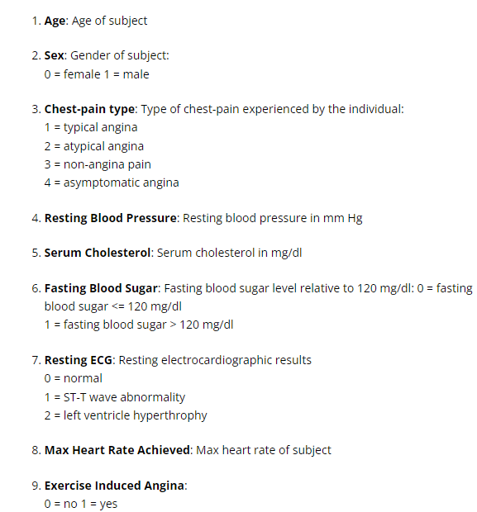
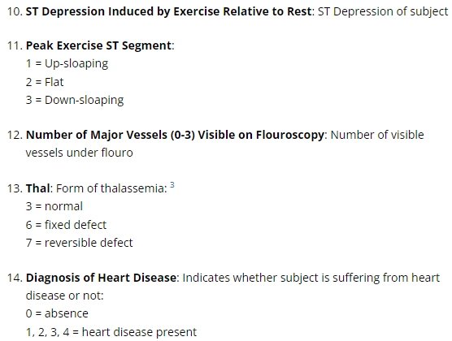
Data Description
The dataset, originally, consists of 303 observations contained within 14 fields/variables. The variable descriptions are provided below:

Slide 4
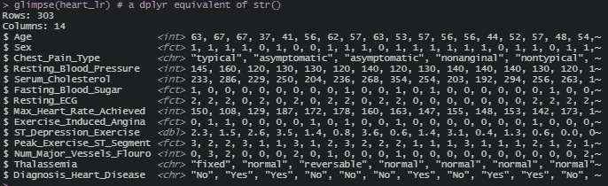
Data Description (Contd.)

Slide 5
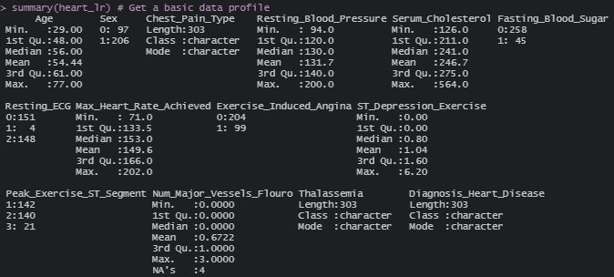
Summary Statistics

Slide 6
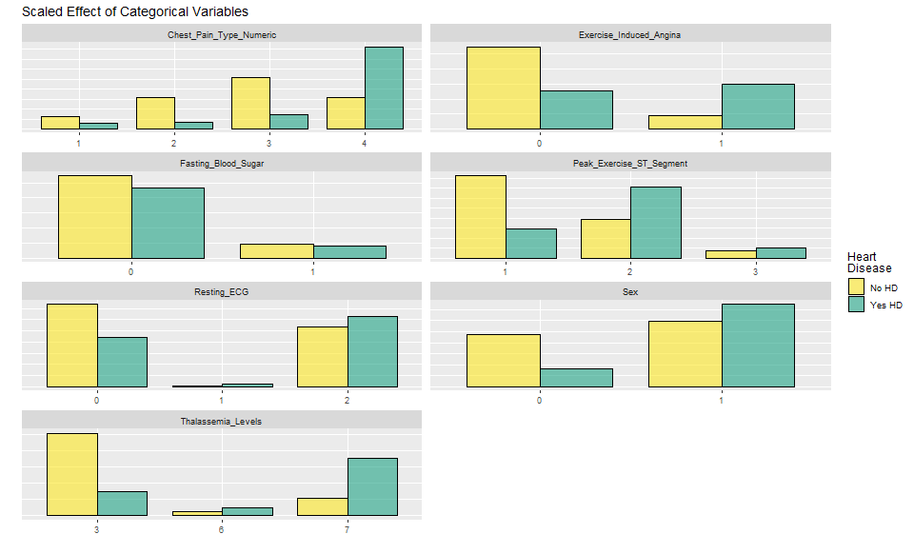
Summary Statistics (Contd.)

Slide 7
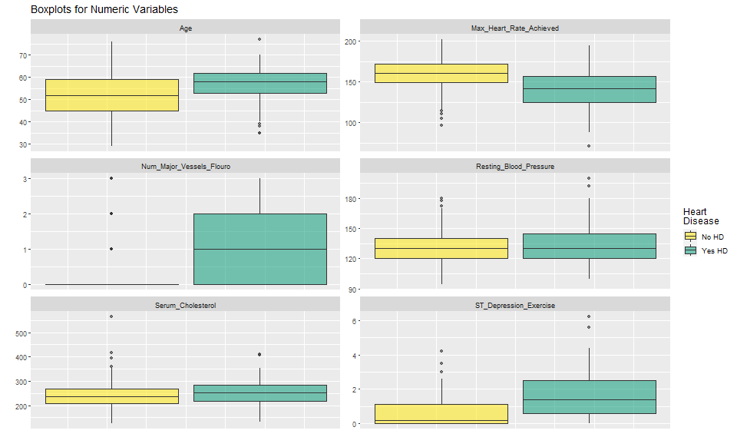
Summary Statistics (Contd.)

Slide 8
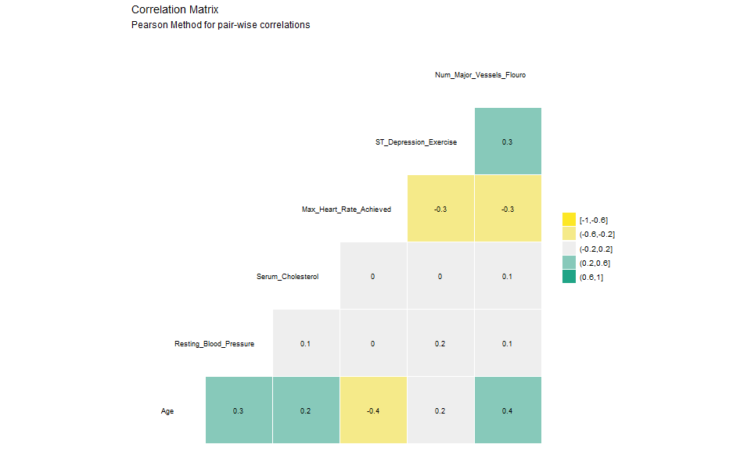
Summary Statistics (Contd.)

Slide 9
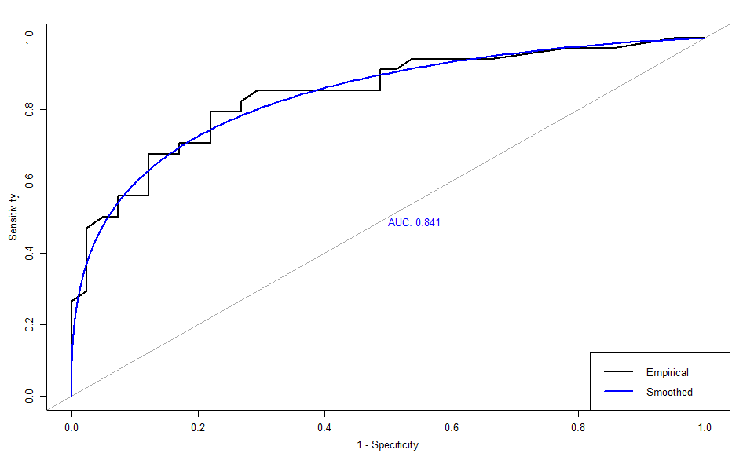
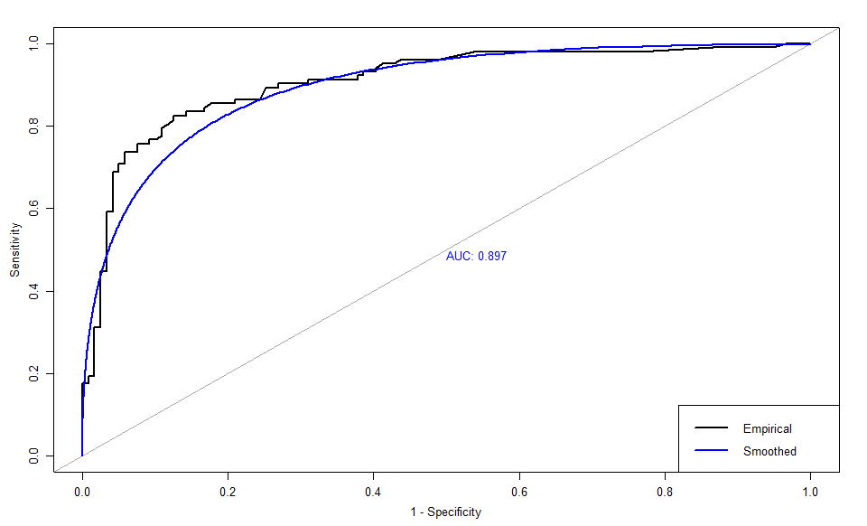
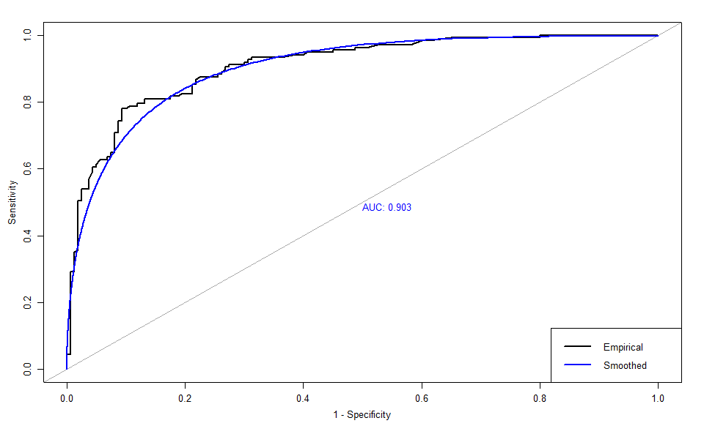
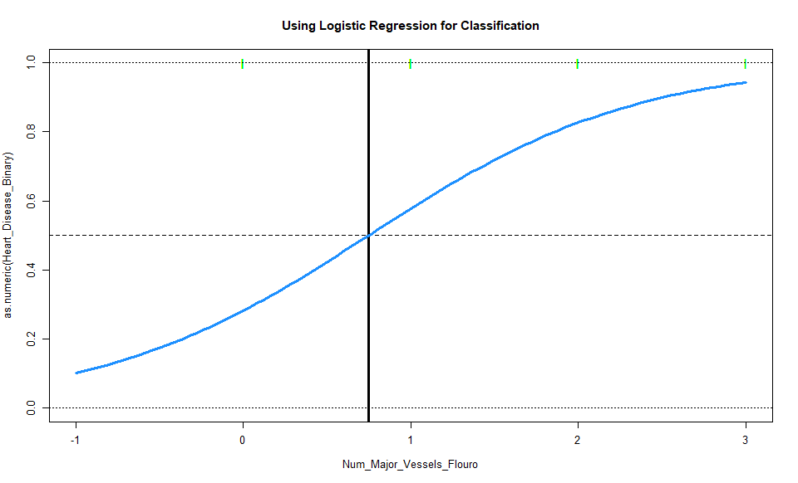
Logistic Regression
Heart_Disease_Binary = -6.052 + 0.951 * (Sex-Male) + 0.02 * (Resting_Blood_Pressure) + 0.174 * (Chest_Pain_Type_Numeric – Level 2) + (-0.11) * (Chest_Pain_Type_Numeric – Level 3) + 2.04 * (Chest_Pain_Type_Numeric – Level 4) + 0.892 * (Thalassemia – Level 6) + 1.835 * (Thalassemia – Level 7) + 1.174 * (Num_Major_Vessels_Fluoro)

Slide 10
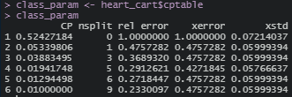
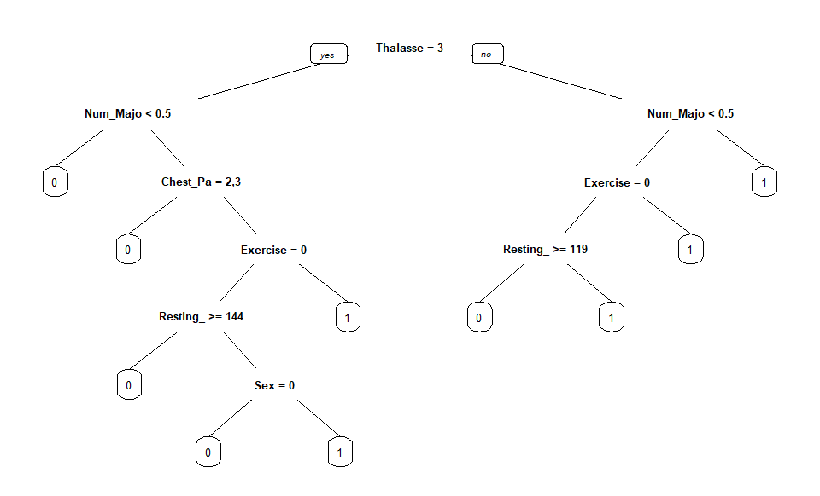
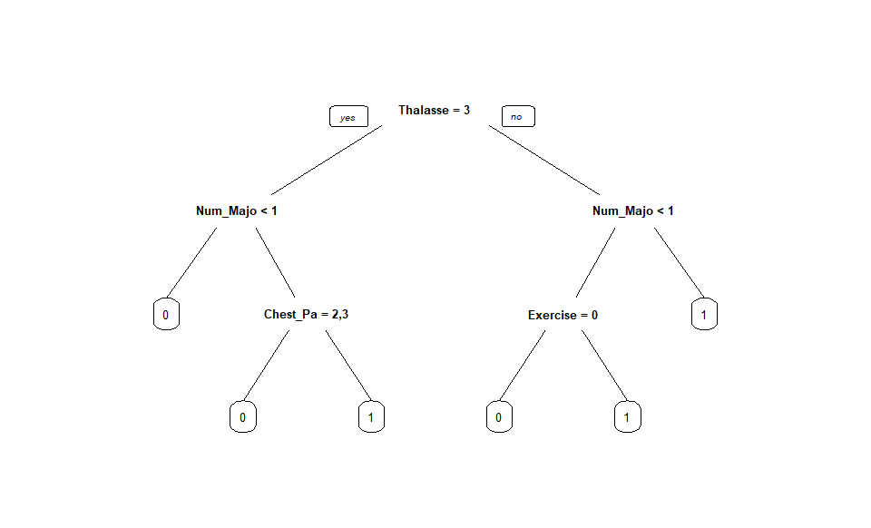
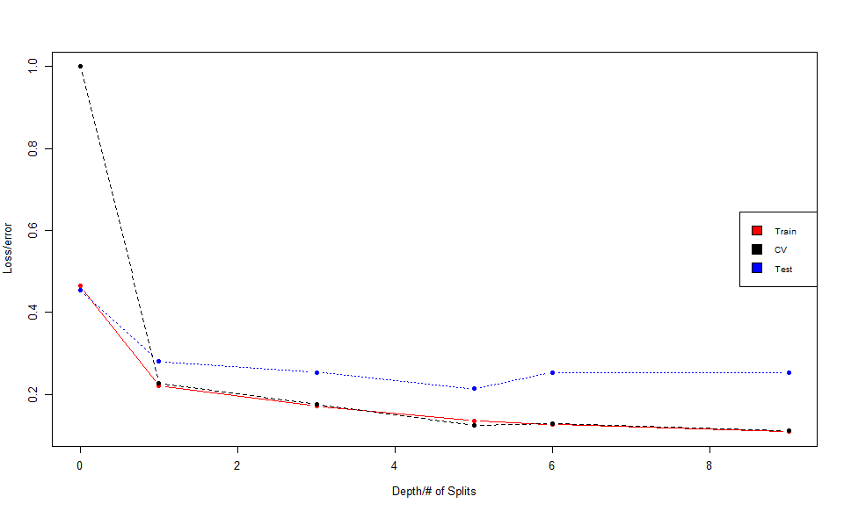
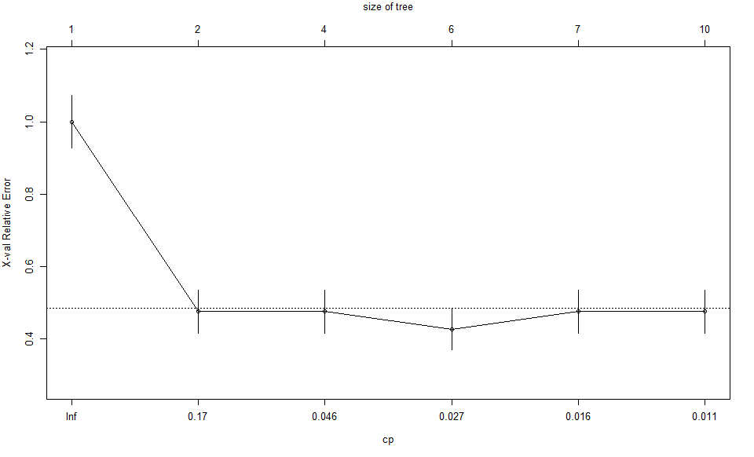
CART Model
Unpruned
Pruned

Slide 11
Summary Table: Logistic Regression

Slide 12
Summary Table: CART Model

